Slide 1




Adobe Analytics Challenge 2021
Team Adobee
Yu Zhang, Sam Probber, Hojin Lee

Slide 2
Content
Business Overview
Business Problem Analysis
Time Period
Customer Behavior (Save for Later & Wishlist)
Insights
Customer Loyalty Segmentation (New, Return, & Loyal)
Impact ($)
6. Conclusion & Recommendations

Slide 3

Business Overview
The mission of The Walt Disney Company is to entertain, inform and inspire people around the globe through the power of unparalleled storytelling, reflecting the iconic brands, creative minds and innovative technologies that make ours the world’s premier entertainment company.
Consumer Insights, Measurement, & Analytics (CIMA) team is focused on inspiring consumer -centric, data-driven, high return decision making that leverages keen insights and relevant data at the core of every business decision. CIMA’s objective is to influence and inform marketing strategy development and enterprise-wide executive-level decision-making by measuring, analyzing, synthesizing, and interpreting a broad spectrum of data, including media effectiveness, sales results, theme park attendance, resort room nights, primary and secondary research findings, and other key business driver metrics.

Slide 4
Business Problem Analysis
Questions
What behaviors are most indicative of subsequent purchases by customers and how can we encourage these behaviors?
Objective
Identify distinctive pre-purchase behavior exhibited by purchasers who complete multiple orders.
Initial Assumptions
Customer behavior metrics we expected to examine included page views, average time on site, entry page, flow, product views, cart interactions, and checkout progression.
*All analysis is from the Disney Web data suite

Slide 5
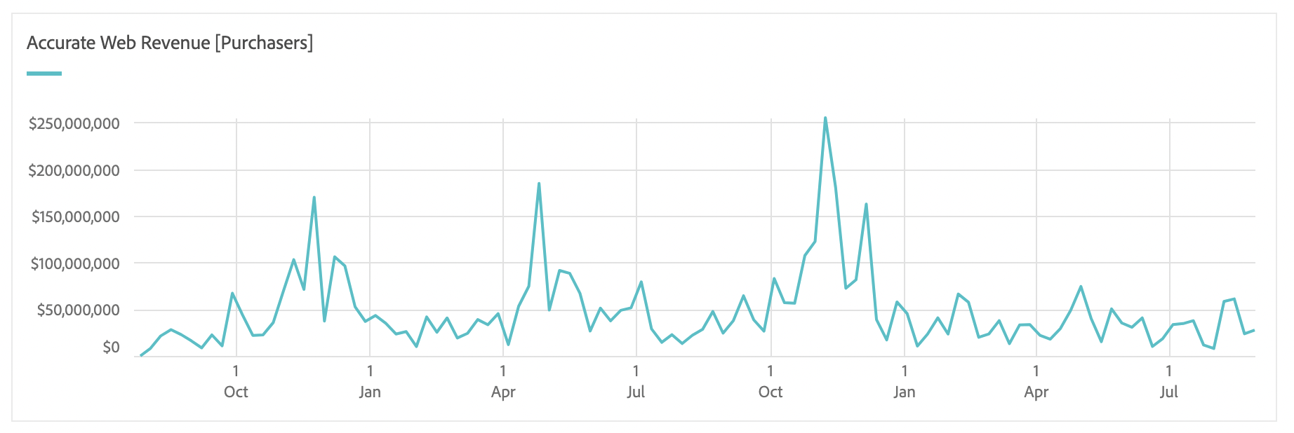
Time Periods - Q4 of 2019 & 2020: Holiday Season
Notes:
Selected periods because of the seasonality of Disney web data. Periods of high revenue that occurred in both years for which there is data.

Slide 6
Site Visitor Feature Utilization
Wishlist
Save For Later
Notes:
Through segment comparisons between one-time purchasers and repeat purchasers, we found use of these features resulted in the largest difference scores

Slide 7
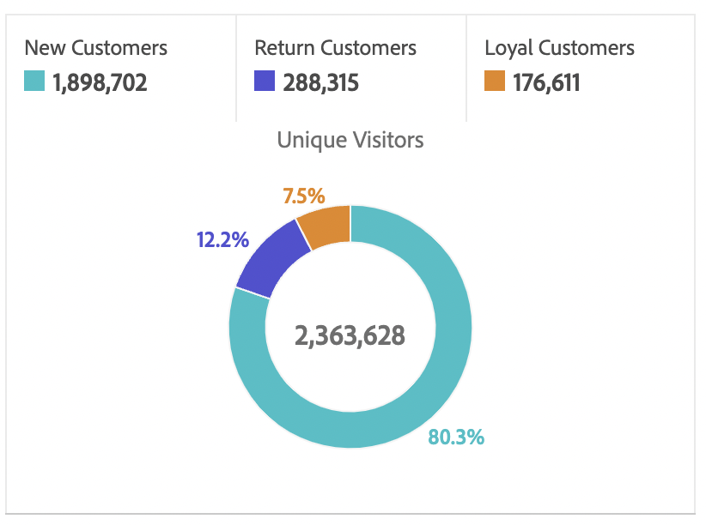
Q4 2020 Customer Loyalty Segmentation
At the time of the hit,
New customers: The visitor made a single purchase before.
Return customers: The visitor made two purchases before.
Loyal customers: The visitor made three or more purchases before.
Notes:
Once we identified which metrics we were going to analyze, we decided to use the Customer Loyalty dimension for further behavior analysis (non-customers excluded because they didn’t make purchases).

Slide 8
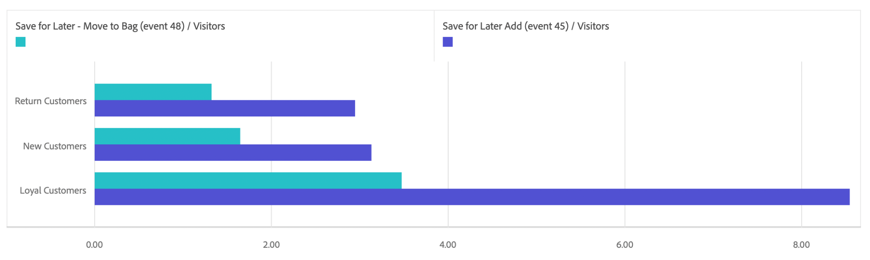
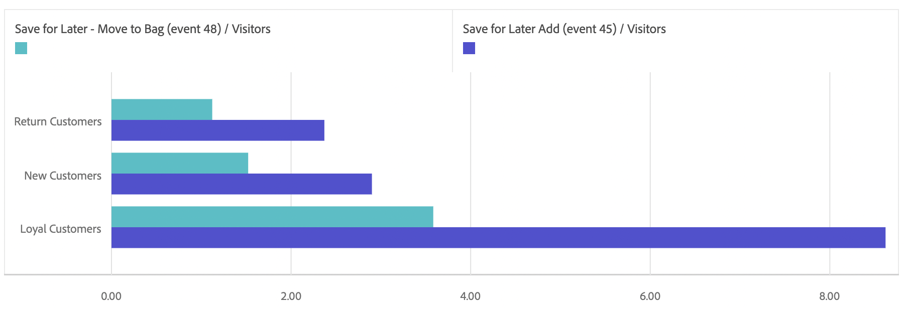
Save for Later - Customer Loyalty
Q4 2019
Q4 2020
Notes:
Customers who use the save for later feature add nearly half their total products saved to their bags

Slide 9
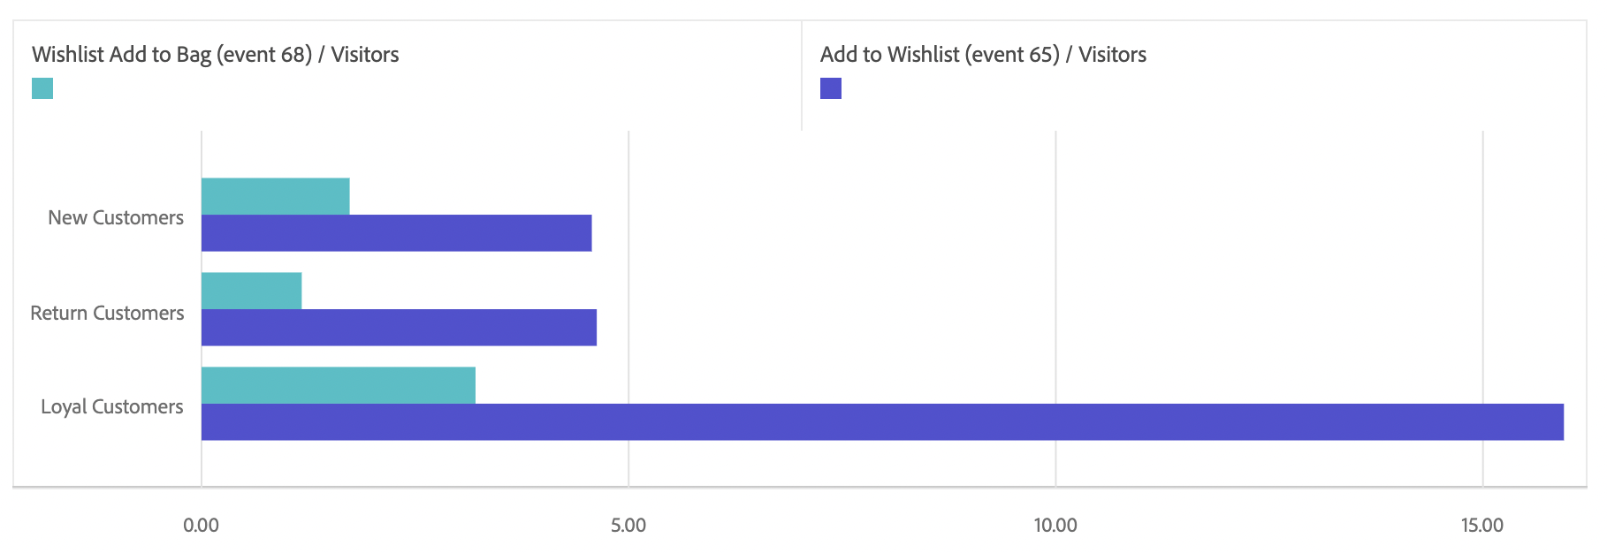
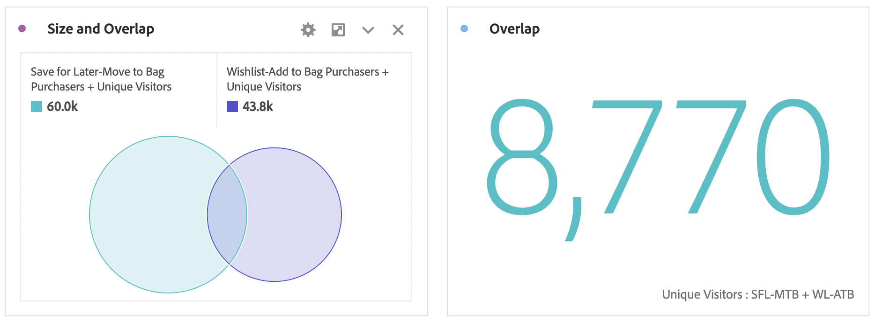
New in Q4 2020 Wishlist - Customer Loyalty
Notes:
Customers who used the Wishlist added more products on average, but moved fewer over to the bag when compared to customers who use the Save for Later feature. In total, over 95K purchasers used either feature.

Slide 10

In Q4 2019...
In Q4 2020...
Customers who moved products from Save for Later to their bags:
Revenue: $58,299,274
Orders: 98,138
Avg. Web Order Revenue: $549
Avg. Products per Order: 1.33
Avg. Price per Product: $413
Customers who moved products from Save for Later to their bags:
Revenue: $204,415,362
Orders: 145,689
Avg. Web Order Revenue: $1,403
Avg. Products per Order: 1.48
Avg. Price per Product: $948
Customers who moved products from the wishlist to their bags:
Revenue: $74,176,816
Orders: 88,791
Avg. Web Order Revenue: $835
Avg. Products per Order: 1.24
Avg. Price per Product: $673
Notes:
These customers account for 17.6% of Q4 2020 Revenue. Average order value 758% higher when using Save for Later and 451% when using the Wishlist

Slide 11

Conclusion & Recommendations

Slide 12
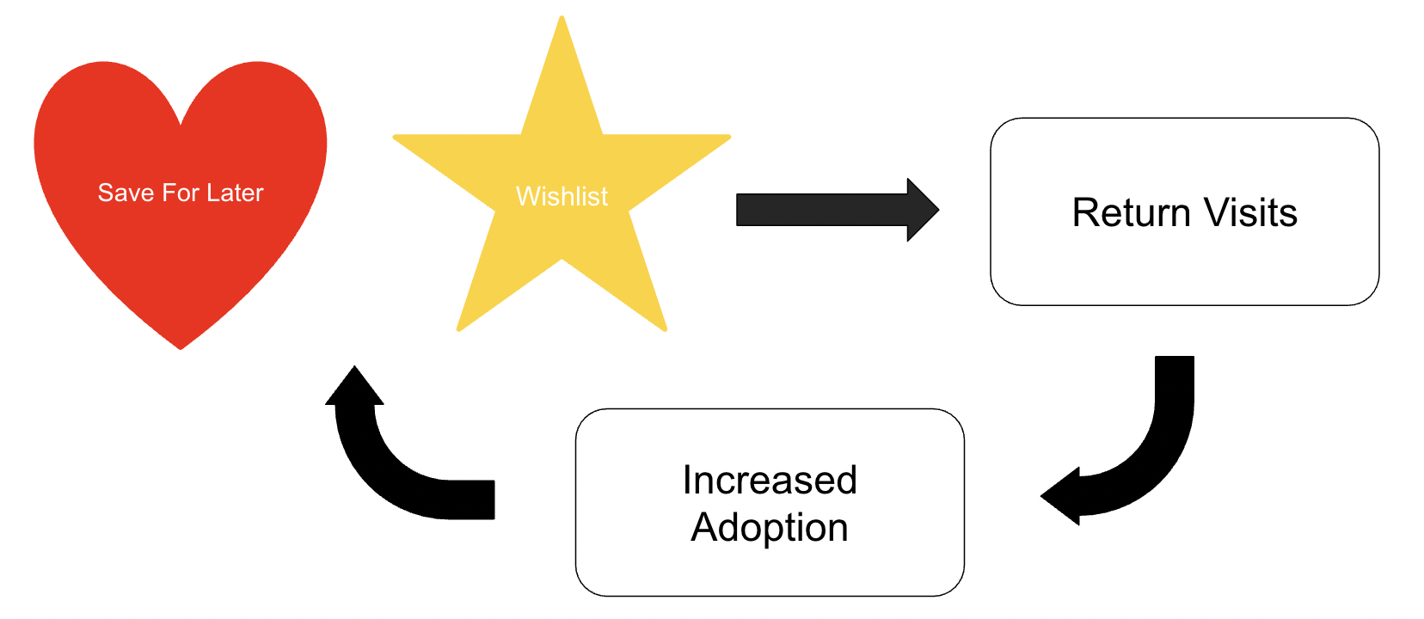
Conclusion
LOW COST!
= MULTIPLE PURCHASES
Notes:
Save for Later and Wishlist features are an inexpensive ways to encourage return visits. As visitors become more familiar with functionality, there will be increased adoption.

Slide 13

Primary Recommendation
Cart Removal pop-ups that prompt customers to save products or add them to a wishlist when they remove products from carts
6.4M cart removals in Q4 2020; without accounting for YoY growth, capturing 0.5% of those products into orders results in $5.9M additional revenue in the quarter
Notes:
(This assumes an average price per product of $185, which was calculated from all orders)

Slide 14

Additional Recommendations
Email re-marketing specifically for saved products and wishlists
Include time sensitive discount offers (e.x, 15% any product from your Wishlist in the next 24 hours)
More flexible return policies for purchasing saved products and products from wishlists
Notes:
Typically used for abandoned carts, email remarketing can be expanded to saved products and wishlists. Users may have forgotten they even created them! Nudging customers who are price sensitive with discounts and more generous return policies will encourage purchases of saved products and from the wishlist, thereby reinforcing their value to customers.

Slide 15

Thank you!
Notes:
We really appreciate the opportunity to participate in this competition!

